Slide 1
Section 1.6 Exponential Models

Slide 2
The Euler number
“The Euler number”

Slide 3
Example 1
Simplify the following exponential functions

Slide 4
Solution to Example 1
Use a scientific calculator we get the following values.

Slide 5

Example 2
Graph $y=e^{x}$

Slide 6
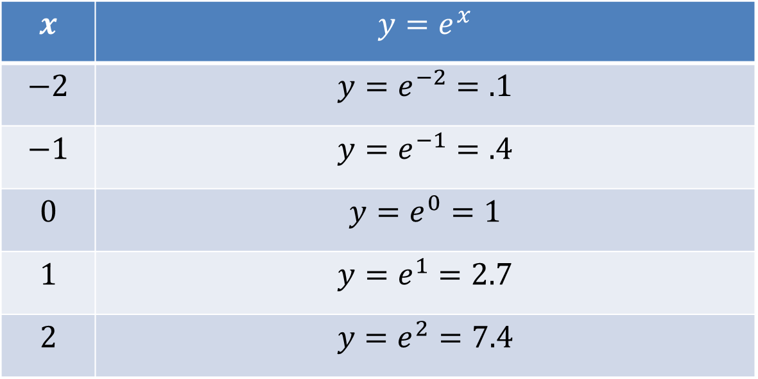
Solution to Example 2
Graph $y=e^{x}$
$$x$$ | $$y=e^{x}$$
$$−2$$ | $$y=e^{−2}=.1$$
$$−1$$ | $$y=e^{−1}=.4$$
$$0$$ | $$y=e^{0}=1$$
$$1$$ | $$y=e^{1}=2.7$$
$$2$$ | $$y=e^{2}=7.4$$

Slide 7

Solution to Example 2
Graph of $y=e^{x}$

Slide 8
Example 3
Graph $y=e^{x}+2$

Slide 9
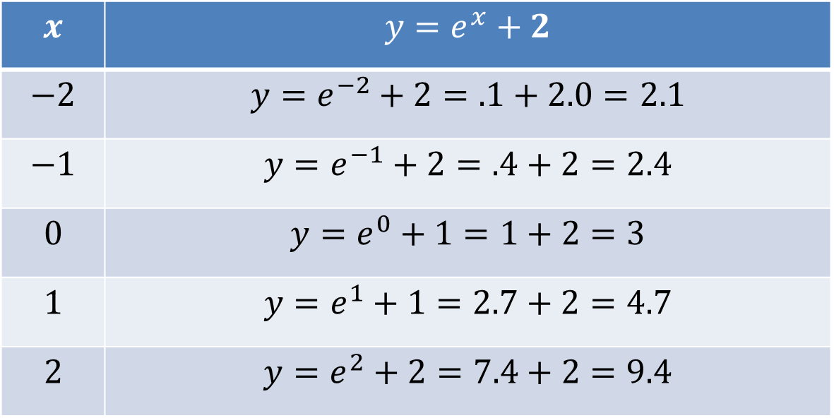
Solution to Example 3
Graph $y=e^{x}+2$
$$x$$ | $$y=e^{x}+2$$
$$−2$$ | $$y=e^{−2}+2=.1+2.0=2.1$$
$$−1$$ | $$y=e^{−1}+2=.4+2=2.4$$
$$0$$ | $$y=e^{0}+1=1+2=3$$
$$1$$ | $$y=e^{1}+1=2.7+2=4.7$$
$$2$$ | $$y=e^{2}+2=7.4+2=9.4$$

Slide 10
Solution to Example 3
Graph

Slide 11
Exponential Models
Exponential models are used to predict human populations, animal populations, money growth, pollution growth, and other aspects of society that fit exponential models. The variable of an exponential model is found in the exponent of the equation.

Slide 12

Exponential Growth
$P=P_{0}e^{kt}$
$$P=New Value$$
$$P_{o}=Initial Value$$
$$k=Rate$$
$$t=Time$$

Slide 13
Example 3
The population of the United States is 320 million, what would be the population of the U. S. be in 20 years if its population would growth at a steady rate of .7 % for 20 years?

Slide 14

Solution to Example 3
$$P_{o}=320 million$$
$$k=.007$$
$$t=20 years$$
$$P=P_{0}e^{kt}=320e^{(.007)(20)}=320e^{.14}≈368 million$$

Slide 15
Example 4
The population of Blacksburg, Virginia is 41,000, what would be the population in 10 years if Blacksburg would grow at a rate of 1.1 % per year?

Slide 16

Solution to Example 4
$$P_{o}=41,000$$
$$k=.011$$
$$t=10 years$$
$$P=P_{0}e^{kt}=41,000e^{(.011)(10)}=41,000e^{.11}≈45,767$$

Slide 17
Example 5
Past Study:
In 1995 the United States had greenhouse emissions of about 1400 million tons, where as China had greenhouse emissions of about 850 million tons. If in the next 25 years China greenhouse emission grew by 4 percent and the U. S. greenhouse emission grew by 1.3 percent, what would the emissions in tons for both countries in 2020?

Slide 18
Solution to Example 5
US Emissions:

Slide 19
Solution to Example 5
China’s Emissions

Slide 20
Exponential Decay
Exponential decay models are use to measure radioactive decay, decreasing populations, Half-life, and other elements that fit an exponential model. Again, the one variable in an exponential decay models in found in the exponent

Slide 21
Exponential Decay
$P=P_{0}e^{−kt}$
$$P=New Value$$
$$P_{o}=Initial Value$$
$$k=Rate$$
$$t=Time$$

Slide 22
Example 6
A certain population of black bears in the eastern United States has been decreasing by 3.1 percent per year. If this trend keeps up, what will be the population of bears in 20 years if there are currently 1000 bears.

Slide 23
Solution to Example 6
Use the decay model

Slide 24
Example 7
A certain isotope decreases at a rate of 5% per year. If there is currently 340 grams of the isotope, how many grams of the isotope will there be in 20 years?

Slide 25
Solution to Example 7
Use the decay model

Slide 26
Example 8
A certain isotope decreases at a rate of 6% per year. It there is currently 250 grams of the isotope, how many grams of the isotope will there be in 25 years?

Slide 27
Solution to Example 8
Use the decay model

